Slide 1

Rein: Taming Tail Latency in Key-Value Stores via Multiget Scheduling
Waleed Reda, Marco Canini, Lalith Suresh, Dejan Kostic, Sean Braithwaite
Inês Garcia 99083, João Costa 99088, Miguel Mendo 99111

Slide 2

Introduction
Context: The importance of reducing tail latencies in distributed key-value stores.
Problem: Variability in latency distributions for multiget requests in key-value stores like Cassandra.
Objective: To reduce tail latencies using inter-multiget scheduling.

Slide 3
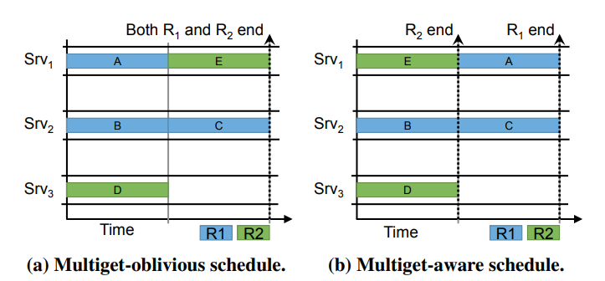
Motivation
By profiling SoundCloud CassandraDB, they noticed that high latency sub-requests were withholding the smaller faster sub-requests, consequently bottlenecking the DB's throughput
They could easily theorize that if they held back the lighter sub-requests until the system could fulfil the heavier ones, it would free resources to reply to other overall less latent requests.

Slide 4
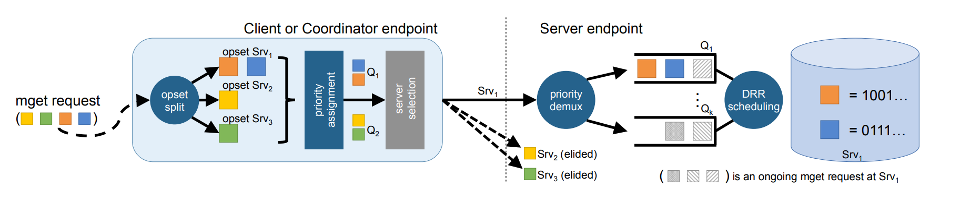
System Design Overview
A system designed to reduce tail latencies via inter-multiget scheduling.
Key Techniques:
Identifying bottlenecks in multiget requests.
Scheduling operations to minimize the impact of these bottlenecks.
Shortest Bottleneck First (SBF)
Slack-Driven Scheduling (SDS)
Multi-level queues with Deficit Round Robin (DRR)

Slide 5
Rein specification
Priority scoring / Bottleneck estimation
There are too many variables to consider
Metrics won't help because they'll be too late, and they aren't free to calculate
There is very low correlation between size of operation and RTT
The solution: They found out that the number of operations in the request has enough correlation with the RTT, and it is easy to calculate

Slide 6
Rein specification
Shortest Bottleneck First (SBF)
Give priority to operations that belong to low bottleneck requests
This can cause starvation on heavy requests' side, so waiting time increases the operation's priority
Slack-Driven Scheduling (SDS)
Slack = how much time can it potentially wait for the request's bottleneck
Incorporate slack into the priority of the sub-request (x):
SDS(x) = (cost(x) + slack(x))/size(x)

Slide 7
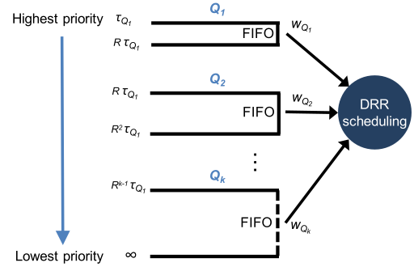
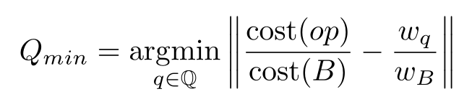
Rein specification
Multi-level queueing
DRR-based scheduling
Assign the bottleneck of the request to a queue according to its cost
Assign the remaining sub-requests to queue with lower priority

Slide 8
Evaluation
16 m3.xlarge AWS EC2 instances: 15 GB of memory, 2x40GB SSD, and 4 vCPUs.
To generate workloads: modified version of the YCSB, configured it to run on a separate node.
They inserted rows into Cassandra with value sizes generated following the distribution of Facebook’s Memcached deployment
Replication factor of partitions: 3
Concurrency level: 8
Consistency level for all requests: 1
The automatic paging feature in Cassandra was disabled to make sure the queries were not sent in a sequential manner.

Slide 9
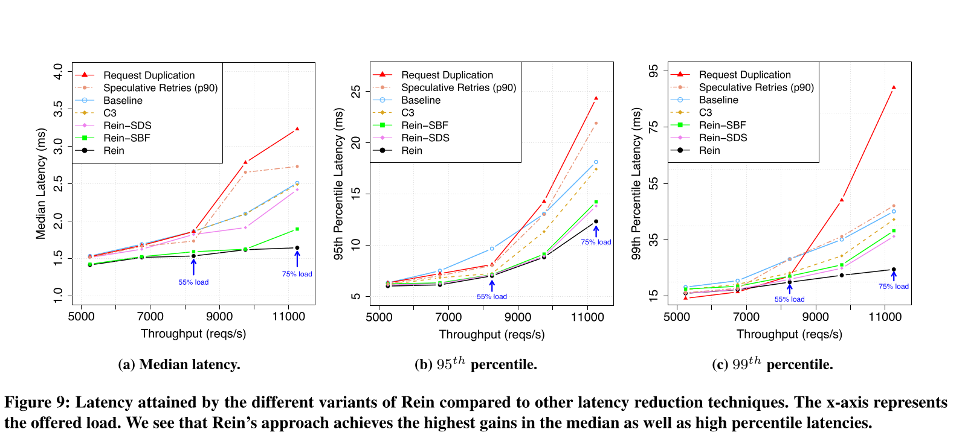
Evaluation

Slide 10
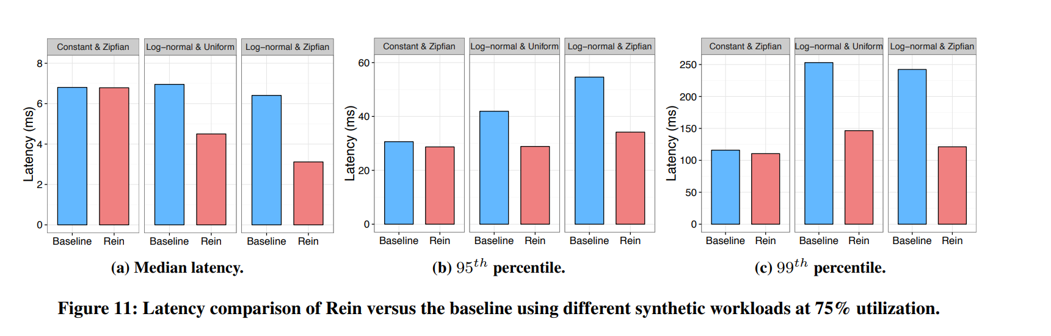
Evaluation

Slide 11
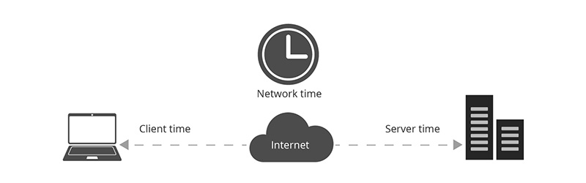
Conclusion
Investigation of the latency-causing factors
Assessment of potential for latency reduction
Design and Implementation of Rein
Evaluation

